Slide 1
A Practical Guide To Real-Time Neural Translation
Jacob Devlin
Microsoft Research

Slide 2
Introduction

Slide 3
Introduction
Neural network models have seen an incredible resurgence in recent years, obtaining state-of-the-art results in vision, speech recognition, and many other tasks
More recently, they have shown substantial improvements in machine translation
Common issues with neural net models:
Slow to use in decoding
Difficult to train

Slide 4
Overview
Part 1: Neural Translation Models at MSR
Summary: Describes three types of neural models which are used as additional features in the MSR-MT phrasal decoder, and how we made them fast enough for production
Part 2: Tips and Tricks for training Neural Models
Summary: Explores several important questions that arise when training any text-based neural model
What is the best technique for using large target vocabularies?
When is it important to pre-train word embeddings?
Do adaptive learning/momentum methods out-perform stochastic gradient descent?
What techniques are best for training stable/robust models without babysitting?
Are recurrent models inherently more powerful than feed-forward models?

Slide 5
Neural Network Language Models (NNLMs)
Feed-forward NNLM
Recurrent NNLM
Output
Output
Output
aardvark = 0.000041
aardvark = 0.000054
aardvark = 0.0082
…
…
…
drove = 0.045
to = 0.267
store = 0.0191
…
…
…
zygote = 0.00003
zygote = 0.000009
zygote = 0.003
Hidden 2
Recurrent Hidden
Recurrent Hidden
Hidden 1
Embedding
Embedding
Embedding
Embedding
Embedding
Embedding
he
drove
he
drove
to
the

Slide 6
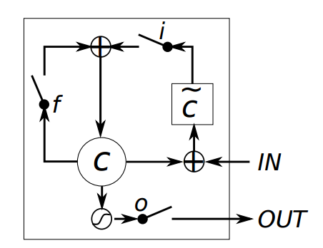
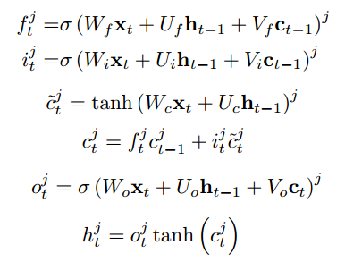
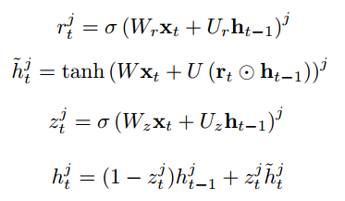
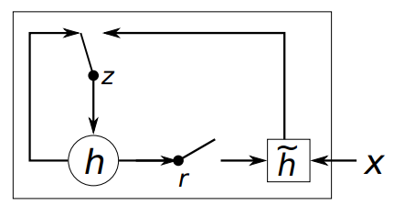
Recurrent Architectures
LSTM/GRU work much better than standard recurrent
They also work roughly as well as one another
Long Short Term Memory (LSTM)
Gated Recurrent Unit (GRU)
Diagram Source: Chung 2015

Slide 7
Neural Translation Models
Neural translation models are extensions of NNLMs that also use source context
Our approach: Use feed-forward neural network models as additional features in traditional engines
Devlin et al. 2014 – “Fast and Robust Neural Network Joint Models for Statistical Machine Translation”
Model different aspects of MT: lexical translation, language modeling, source re-ordering
Pragmatic advantage: Can get significant quality gains and faster translation

Slide 8
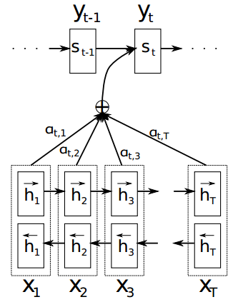
Neural Translation Models
Alternative approach: “Pure” neural network models
Not discussed explicitly, but second half of talk gives tips on training any text-based neural network model
Bahdanau et al. 2014
“Neural Machine Translation by Jointly Learning to Align and Translate”
Recurrent model responsible for producing target words and picking the next source word to give “attention” to
Sutskever et al. 2014
“Sequence to Sequence Learning with Neural Networks”
Encode source into fixed length vector, use it as
initial recurrent state for target decoder model
Attention Model
Sequence to Sequence Model or Encoder-Decoder Model

Slide 9
Skype Translator
Primary focus for last two years: Skype Translator
Real time speech-to-speech translation
Currently supports English, Spanish, Chinese, French, Italian, German
Support for more languages over next year
Publically available as Windows 8/10 standalone app
Skype Desktop support coming very soon!

Slide 10
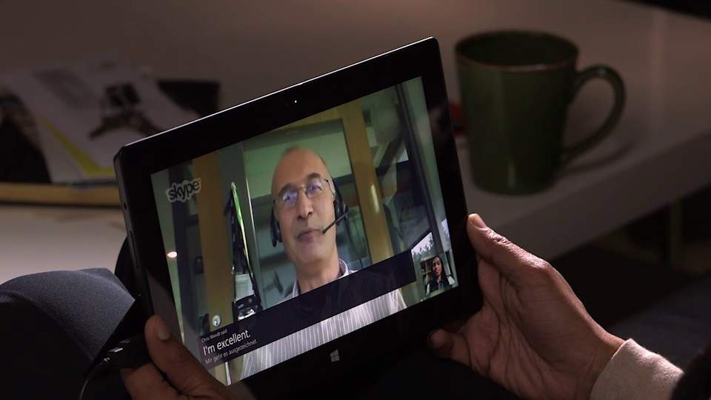
Skype Translator

Slide 11
Part 1: Neural Translation Models at MSR

Slide 12
Overview of MT System
MT decoder:
Phrasal system, similar to Moses
5-gram KNLM
Training data:
200M-3B words of parallel data
5B-30B words of monolingual training
Neural network models:
Trained on word-aligned parallel training data
Fully integrated into decoding, no rescoring
Log probabilities from neural net models used as additional features
All feature weights optimized for Expected BLEU

Slide 13
Neural Net Joint Model (NNJM)
Source: werde ich das mit der bank morgen endlich klaeren koennen
Target: i will finally be able to clarify that with the bank tomorrow
P(tomorrow | with the bank; mit der bank morgen endlich klaeren koennen)
with
the
bank
...
morgen
…
apple
…
tomorrow
…
zylophone
Embedding
Hidden
Label
Notes:
Werde -> will
Ich -> i
Das -> that
Mit -> with
Der -> the
Bank -> bank
Morgen -> tomorrow
Endlich -> finally
Klaeren -> clarify
Koenne -> Be able to
VERDUH EECH DAS MIT DAYRE BAHNK MAHRGEN END LEAK CLEARIN’ CUNNIN’

Slide 14
Neural Net Lexical Translation Model (NNLTM)
Source: werde ich das mit der bank morgen endlich klaeren koennen
Target: i will finally be able to clarify that with the bank tomorrow
P(be_able_to | morgen endlich klaeren koennen </s> </s> </s>)
morgen
endlich
klaeren
koennen
</s>
…
can
may
be able to
may be
possible
Embedding
Hidden
Label

Slide 15
Neural Net Reordering Model (NNROM)
NNJM does not model how we got to current source word
Standard distortion model: Predict jump distance
Predict a label [-5, -4, … +4, +5] given the current source/target context
Easy to use rich context based on where we’re jumping from, but not where we’re jumping to
Idea of NNROM: Construct output layer on the fly
Feed each source word + context into the a neural net to produce a vector
Use those vectors to construct an output layer on the fly
This output layer encodes rich context about the word being jumped to
Same basic idea as Montreal’s neural attention model
But the Montreal model does not require an existing word alignment

Slide 16
Neural Net Reordering Model (NNROM)
Source: werde ich das mit der bank morgen endlich klaeren koennen
Target: i will finally be able to clarify that with the bank tomorrow
P(Word-8 | <s> i will; <s> <s> <s> werde ich das mit)
Label
Hidden
<s>
i
will
…
werde
…
Word-1
…
Word-8
…
Word-10
Dist=1
werde
ich
…
der
Dist=8
der
endlich
…
koennen
Input
Embedding
Input
Hidden
Output
Label
Embedding
Label
Embedding

Slide 17
Neural Network Model Results
BLEU (single-reference) results on conversational test sets
Results by Model
Language | Baseline | +NNJM | +NNLTM | +NNROM | Total
English-Spanish | 40.8 | +1.4 | +1.9 | +0.2 | +3.5
English-German | 37.8 | +2.6 | +0.8 | +1.0 | +4.4
Total Improvement
Language | Baseline (Transcript) | + All NN Models | Baseline (ASR Output) | + All NN Models
English-Spanish | 40.8 | +3.5 | 33.2 | +2.8
English-German | 37.8 | +4.4 | 29.8 | +2.5
English-Italian | 45.0 | +2.6 | 37.2 | +1.8
Spanish-English | 56.9 | +3.5 | 44.1 | +1.7
German-English | 47.2 | +2.8 | 35.1 | +2.1
Italian-English | 43.2 | +2.3 | 34.4 | +2.2

Slide 18
Self-Normalization
Problem: Computing softmax over vocabulary at test time is extremely expensive
We only care about the probability for the observed word
Solution: Train model to be approximately normalized
In language models, $Z$ cannot be ignored, because it changes based on the context
Softmax
$$P\left(x_{i}\right)=\frac{e^{s_{i}}}{Z_{i}}, where Z_{i}=\sum_{j∈V}{e^{s_{j}}}$$
$s_{i}$= score of word $i$ from network
$V$ = vocabulary
Softmax (In log space)
$log(P\left(x_{i})\right)=s_{i}−log⁡(Z_{i}$)
Approximate Normalization
$\log\left(Z_{i}\right)≈0$ for all $i$

Slide 19
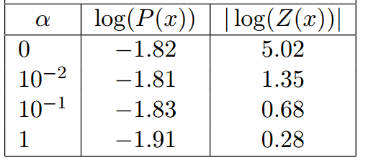
Self-Normalization
Add explicit term to objective function to encourage log denominator to be close to zero:
$α$ trades off normalization error with model accuracy
Values of 0.025 – 0.1 are good
$$L=\sum_{i}{\left[\log\left(\frac{e^{s_{i}}}{Z_{i}}\right) + α{\log\left(Z_{i}\right)}^{2}\right]}$$
Standard cross-entropy loss
New term

Slide 20
Pre-Computation
The “pre-computation trick”: The matrix-vector product between the word embedding and a section of the first hidden layer can be computed offline
Pre-Computed Hidden Layer
Hidden Layer
Input Embeddings

Slide 21
Pre-Computation
-0.1 | 0.9 | 1.8 | 1.4 | -0.9 | 1.4 | -0.2 | 1.5 | 0.8
0.2 | -0.9 | 1.2 | 1.3 | 1.8 | 2.0 | -0.4 | 1.7 | -1.4
-1.2 | -0.1 | 0.2 | -1.6 | -0.8 | 1.0 | 0.2 | 2.0 | -1.5
-0.4 | -0.7 | -0.8 | -1.4 | 0.4 | 0.8 | 1.5 | 0.6 | -0.6
Hidden Weight Matrix
drove (Position 1)
2.30
1.85
0.91
0.71
= -0.1*-0.5 + 0.9*-0.3 + 1.8*1.4
drove
= 0.2*-0.5 + -0.9*-0.3 + 1.2*1.4
Word Embeddings
-0.5 | -0.3 | 1.4
= -1.2*-0.5 + -0.1*-0.3 + 0.2*1.4
= -0.4*-0.5 + -0.7*-0.3 + -0.8*1.4
drove (Position 1)
the (Position 2)
red (Position 2)
Hidden Output
Compute
2.30
1.85
0.91
0.71
-1.40
0.41
-0.83
2.66
0.05
-0.71
0.14
-0.32
0.95
1.55
0.22
3.05
P(car | drove the red)
+
+
=

Slide 22
Model Speedups
Self-normalization speeds up test-time lookups by 50x
Pre-computation speeds up computation by another 50x
Only works for 1-layer networks
Our compressed backoff LM implementation can do 700,000 lookups per second
Condition | lookups per second
1-Layer NNJM | 230
+ Self-Normalization | 13,000
+ Pre-Computation | 600,000
1-layer NNJM, 500 hidden nodes,16k vocabulary

Slide 23
Lateral Networks
Problem: Pre-computation only works with single layer networks, but multi-layer networks are more powerful
Solution: Put the hidden layers next to one another
Generalization of max-out networks (Goodfellow 2013)
Each layer can be pre-computed independently
Standard Network
Lateral Network
Output
Output
$$⊗$$
Element-wise multiplication or max
Hidden
Hidden
Hidden
Embedding
Embedding

Slide 24
Lateral Networks
Results using lateral networks
Perplexity Results (NNLM)
MT Results (NNJM)
Condition | Perplexity
KNLM | 91.1
1-Layer | 77.7
2-Layer Standard | 76.2
3-Layer Standard | 74.8
2-Layer Lateral | 72.2
3-Layer Lateral | 71.1
Condition | BLEU | lookups per second
Baseline | 37.95 | -
1-Layer | 40.71 | 600,000
2-Layer Standard | 40.82 | 24,000
2-Layer Lateral | 40.89 | 305,000

Slide 25
Decoding Speed
Question: Even with pre-computation and self-normalization, doesn’t adding 3 new models slow down decoding?
Answer: Yes, if the pruning parameters are kept constant.
But the pruning can be significantly tightened with the neural net models!
NN models much better at discriminating good from bad hypotheses
Condition | BLEU | Words per Sec per CPU
Baseline (Production Skype Translator Models) | 47.2 | 122
+ NN Models, Baseline Pruning | 50.0 | 92
+ NN Models, Tightened Pruning | 49.8 | 184
Condition | BLEU | Words per Sec per CPU
Baseline (Production Skype Translator Models) | 47.2 | 122
+ NN Models, Baseline Pruning | 50.0 | 92

Slide 26
Decoding Speed
Source: werde ich das mit der bank morgen endlich klaeren koennen
Ambiguous word: “bank” or “bench”
Standard Pruning relies on:
(1) Context-free phrase probs
- Which make very weak use of context
bank → bank
bank → the bank
bank → bench
bank → bank ,
bank → finance
(2) The language model
Which requires evaluating many n-grams
clarify with the bank
clear with the bank
sort out with the bank
clarify with the bench
clarify by the bank
sort out with the bench
Neural Net Pruning relies on rich source context
Which can distinguish good from bad translations with many fewer evaluations than the LM
ich das mit der bank morgen endlich klaeren koennen → bank
ich das mit der bank morgen endlich klaeren koennen → the bank
ich das mit der bank morgen endlich klaeren koennen → bench
ich das mit der bank morgen endlich klaeren koennen → bank ,
<s> werde ich das mit der bank morgen klaeren → with
<s> werde ich das mit der bank morgen klaeren → by
<s> werde ich das mit der bank morgen klaeren → at
mit der → with the
mit der → with
mit der → by the
mit der → at the
mit der → on top of

Slide 27
Part 2: Tips and Tricks for Training Neural Models

Slide 28
Large Target Vocabulary
Problem: Softmax over large target vocabulary (30k+ words) is very expensive
Several proposed solutions:
Hierarchical softmax/word classes
Noise contrastive estimation (NCE)
Approximate softmax
Methods used in NNMT papers:
Devlin 2014 – Full softmax
Sutskever 2014 – Full softmax
Jean 2014 (“On Using Very Large Target Vocabulary for Neural Machine Translation”) – Approximate softmax

Slide 29
Large Target Vocabulary – Hierarchical Softmax
Idea: Cluster words into hierarchical tree structure
Can be very deep (binary tree) or very shallow (2-layer tree with word clusters)
Words are represented as leaves
C₁₁
C₂₁
C₂₂
C₂₃
_{cat}
_{dog}
_{pig}
_{red}
_{blue}
_{man}
_{person}

Slide 30
Large Target Vocabulary – Hierarchical Softmax
Scoring: Traverse from root to target word, softmax over siblings at each level
Can skip large portions of the tree
Weakness: Very unfriendly to GPUs/minibatching
Every word in the batch has a different path
C₁₁
C₂₁
C₂₂
C₂₃
_{cat}
_{dog}
_{pig}
_{red}
_{blue}
_{man}
_{person}

Slide 31
Large Target Vocabulary – Hierarchical Softmax
Weakness: Harder to self-normalize
Every set of siblings must be self-normalized, so error is aggregated
Weakness: More expensive at test time
Must compute k dot products (where k is number of nodes from root to leaf), which is significant for pre-computed networks

Slide 32
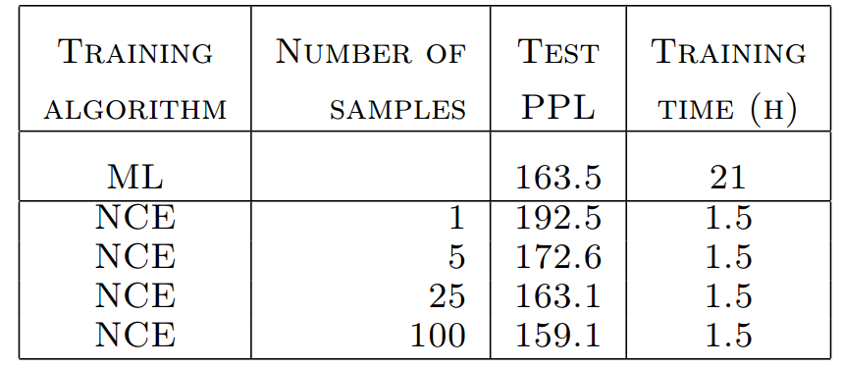
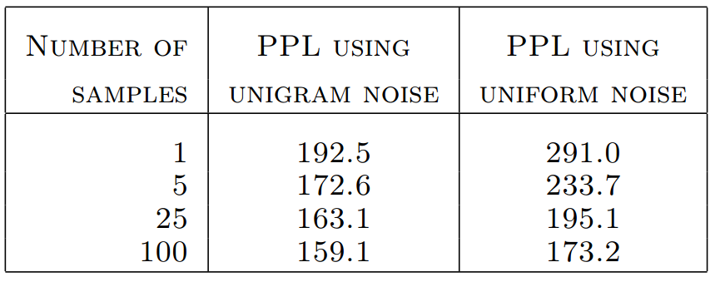
Large Target Vocabulary – NCE
Idea: Train binary classifier to distinguish observed words from randomly sampled words (“noise” words)
Weakness: Unfriendly to GPUs
Every item in the batch should have different negative samples
Weakness: Very sensitive to hyperparameters
Even in original paper, most settings produce poor performance
$P_{θ}^{h}(w)$= Neural net model score
$P_{n}(w)$= Noise sample probability (unigram prior)
$k$ = number of samples (e.g., 10)

Slide 33
Large Target Vocabulary – NCE
Weakness: Worse results than full softmax
Best NCE setup converges at 8 PPL worse than full softmax
Weakness: Big train time improvement possible only if runtime is dominated by output layer
Not the case for complex models, e.g., Montreal’s attention or Google’s seq2seq
Training time improvement require efficient GPU implementation, which is difficult

Slide 34
Large Target Vocabulary – Approximate Softmax
Idea: Softmax over a large subset of words from the full vocab V
Select m most common words as shortlist (always in softmax) (e.g., m = 7000)
Each batch, select n random words as negative samples (e.g., n= 3000)
Advantage: Very GPU friendly
Negative samples shared across minibatch
Crucial trick: Multiply the scores of the negative sampled words by the inverse sample rate$α= {(\left|V\right|−m)}/n$
Full Softmax
Approximate Softmax
$$P_{F}\left(w_{i}\right)= \frac{e^{s_{i}}}{\sum_{j}{e^{s_{j}}}}$$
$$P_{A}\left(w_{i}\right)= \frac{e^{s_{i}}}{e^{s_{i}}+\sum_{j∈m}{e^{s_{j}}}+\sum_{k∈n}{αe^{s_{k}}}}$$

Slide 35
Large Target Vocabulary – Approximate Softmax
Example: Compute P(man | spoke to the)
Full Softmax
Approximate Softmax
Word | $$e^{s_{i}}$$
the | 0.002
man | 0.46
person | 0.26
though | 0.004
red | 0.02
denial | 0.008
big | 0.04
teacher | 0.07
cooked | 0.003
trombone | 0.006
Shortlist
$$α=(10−4)/3=2.0$$
$$\frac{0.46}{\begin{aligned}(0.002+0.46+ … \\ 0.003+0.006)\end{aligned}}$$
$$\frac{0.46}{\begin{aligned}[\left(0.002+0.46+0.26+0.004\right) \\ + \\ 2.0∗(0.008+0.04+0.003)]\end{aligned}}$$
Neg. Samples
$$=$$
$$=$$
$$\frac{0.46}{0.874}$$
$$\frac{0.46}{0.844}$$

Slide 36
Large Target Vocabulary – Approximate Softmax
Settings: 50k vocab, m = 7k shortlist, n =3k neg. samples
Approximates the true softmax almost perfectly
But much faster: 2.8x speedup per epoch in this case
Also works perfectly with self-normalization
English 10-Gram NNLM, 100M words, 50k vocab

Slide 37
Pre-Trained Embeddings
Question: Is it important to pre-train the word embeddings on a large monolingual corpus?
Answer: Yes, if the amount of training data is small
Embeddings pre-trained with word2vec skip-grams on 500M words

Slide 38
Pre-Trained Embeddings
Answer: Probably not, if the amount of parallel training data is large
For NNJM, does not improve final test accuracy
Reduces error faster at the start, but final convergence time is the same

Slide 39
Pre-Trained Embeddings
Tip: Always pre-train embeddings when the number of output labels is small
Even for large scale training data
Example task: Binary classifier for sentence segmentation
Trained on 200M words, sub-sampled to 50% positive/50% negative
Embeddings were pre-trained on exact same data
Model | Log-Likelihood | Accuracy
Random Choice | -0.69 | 50.0%
Feed-Forward Neural Net | -0.25 | 90.0%
FFNN + Pre-Trained Embeddings | -0.20 | 92.2%

Slide 40
Pre-Trained Embeddings
Why? With many labels (e.g., words), backprop is highly discriminating
With few labels (e.g., binary classifier), not enough signal to partition words into good embedding space
Word | Most Similar Embeddings With Pretraining | Most Similar Embeddings No Pretraining
man | woman, boy, girl, mother, person | sobbed, retaliated, tolled, fascination, forestall
red | yellow, blue, pink, green, white | nationalize, wim, jocelyn, deterring, imad
said | says, added, explained, noted, stressed | added, says, noted, though, say

Slide 41
Adaptive Learning/Momentum
Many different options for adaptive learning/momentum:
AdaGrad, AdaDelta, Nesterov’s Momentum, Adam
Methods used in NNMT papers:
Devlin 2014 – Plain SGD
Sutskever 2014 – Plain SGD + Clipping
Bahdanau 2014 – AdaDelta
Vinyals 2015 (“A neural conversation model”) – Plain SGD + Clipping for small model, AdaGrad for large model
Problem: Most are not friendly to sparse gradients
Weight must still be updated when gradient is zero
Very expensive for embedding layer and output layer
Only AdaGrad is friendly to sparse gradients

Slide 42
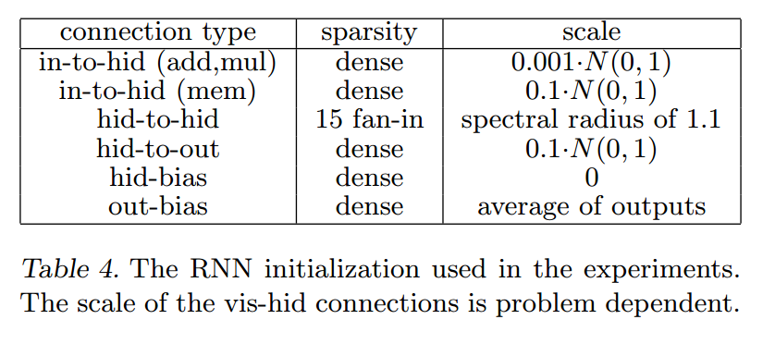
Adaptive Learning/Momentum
But isn’t it really important?
Sutskever 2013 (“On the importance of initialization and momentum in deep learning”)
Sutskever 2014 – Obtained SOTA MT accuracy using 4-layer, 384M parameter sequence-to-sequence LSTM with:
Plain SGD + gradient clipping
Weights initialized from the uniform distribution [-0.08, 0.08]

Slide 43
Adaptive Learning/Momentum
Maybe it’s LSTMs vs. standard RNNs?
LSTMs do not have vanishing gradients temporally
But still have exploding gradients, and gradients still vanish in stacked layers
Core issue: DNNs and deep RNNs have gradients with high variance
Momentum and careful initialization lower the variance
As does AdaGrad/AdaDelta/etc.
But simple gradient clipping also does!
The initial learning rate can be raised significantly without causing degenerate models

Slide 44
Adaptive Learning/Momentum
For LSTM LM, clipping allows for a higher initial learning rate
On average, only 363 out of 44,819,543 gradients are clipped per update with learning rate = 1.0
But the overall gains in perplexity from clipping are not very large
Model | Learning Rate | Perplexity
10-gram FF NNLM | - | 52.8
LSTM LM w/ Clipping | 1.0 | 41.8
LSTM LM No Clipping | 1.0 | Degenerate
LSTM LM No Clipping | 0.5 | Degenerate
LSTM LM No Clipping | 0.25 | 43.2

Slide 45
Robust Training
Problem: Trainings often are often degenerate or sub-optimal, especially with deep recurrent networks
A few simple techniques for increasing robustness:
Updates clipped to range: [-0.01, 0.01]
Weights clipped to range: [-0.5, 0.5]
update = learning_rate*-gradient update = max(-0.01, min(0.01, update))
weight = weight + update
weight = max(-0.5, min(0.5, weight))

Slide 46
Robust Training
Early stopping with sliding window validation error
Define “epoch” as min(data_size, 25M words)
Sliding window: If epoch is 20,000 batches, compute validation error at batch 19,000, 19,100, … 20,000 and take the median
Validation error jumps up and down a lot
Especially for clipped recurrent networks:
English LSTM LM
100M words training

Slide 47
Feed Forward vs. Recurrent LMs
Question: Are LSTM LMs inherently more powerful than feed forward NNLMs?
Answer: Yes
Feed-forward model: 1000 hidden nodes (more didn’t help)
Recurrent model: 1000 hidden nodes
n-gram Order | Hidden Layers | Perplexity
5 | 3 | 58.9
7 | 3 | 55.2
10 | 3 | 52.8
15 | 3 | 51.9
20 | 3 | 51.6
LSTM | 1 | 45.1
LSTM | 2 | 41.8
English LM, 100M words, 10k output vocab

Slide 48
Feed Forward vs. Recurrent LMs
Result: LSTM outperforms FFNN, even when RNN context is truncated
LSTM was trained with special truncation token
English LM, 100M words, 10k vocab

Slide 49
Feed Forward vs. Recurrent LMs
Qualitative analysis: LSTM is much better at “parsing” the input
Segment | 20-gram FF Log Prob | Recurrent Log Prob
the lawsuit , filed wednesday on behalf of linda and robert lott of birmingham , alleges | -8.9 | -2.7
the lawsuit alleges | -2.9 | -2.8
some journalists said the claim that instant news was more incendiary than reports delivered more slowly was | -9.3 | -1.5
some journalists said the claim was | -1.8 | -0.8
Word being predicted is in bold

Slide 50
Conclusions
Neural network models can make MT better and faster
How to train powerful, robust models “quickly”:
Use approximate softmax for dealing with large vocab
Use gradient clipping
Use sliding-window early stopping
Pre-train the embeddings if the data or number of labels is small
Recurrent networks can model long-distance phenomena that feed forward networks can’t

Slide 51
MSR Machine Translation Group is Hiring!
Apply online:
https://careers.microsoft.com/ - Search for “MT Scientist”
Or e-mail one of us:
Arul Menezes (arulm@microsoft.com), MT Group Manager
Jacob Devlin (jdevlin@microsoft.com), Senior MT Scientist
Talk to me at WMT/EMNLP!

Slide 52
blogs.msdn.com/translator
linkedin.com/company/Microsoft-Translator
twitter.com/MSTranslator
facebook.com/MicrosoftTranslator

Slide 53
Auxiliary Slides

Slide 54
Approximate Softmax Comparison
Assume:
vocab size = 100k, hidden nodes = 1000, minibatch = 100, sent. length = 50
Method 1: Softmax over whole vocab from data chunk
Memory usage: 100*50*30k + 1000*30k = 180M
Method 2: Softmax over random words from whole vocab
Memory usage: 100*50*10k + 1000*100k = 150M
Either way, multiplying by $α$ correctly approximates the softmax

